Slide 1
MATH221 Mathematics for Computer Science
Unit 8
Introduction to Combinatorics

Slide 2
Learning Objectives
Introduce Multiplication and addition Rules: these form the basis for work on combinatorics.
Introduce permutation and combination.

Slide 3
Introduction
Combinatorics is an area that primarily concerning with counting that is very important in Statistics especially in the area of probability.
This unit will study the basic model for counting.
To use this model, we must interpret the problem according to the model.

Slide 4
The Multiplication Rule
Theorem 8.1 The Multiplication Rule
If an operation consists of k steps and
the first step can be performed in n₁ ways,
the second step can be performed in n₂ ways (regardless of how the first step was performed),
:
the k^{th} step can be performed in n_{k} ways (regardless of how the preceding steps were performed),
Then the entire operation can be performed in
n₁ × n₂ × n₃ × … × n_{k} ways.

Slide 5
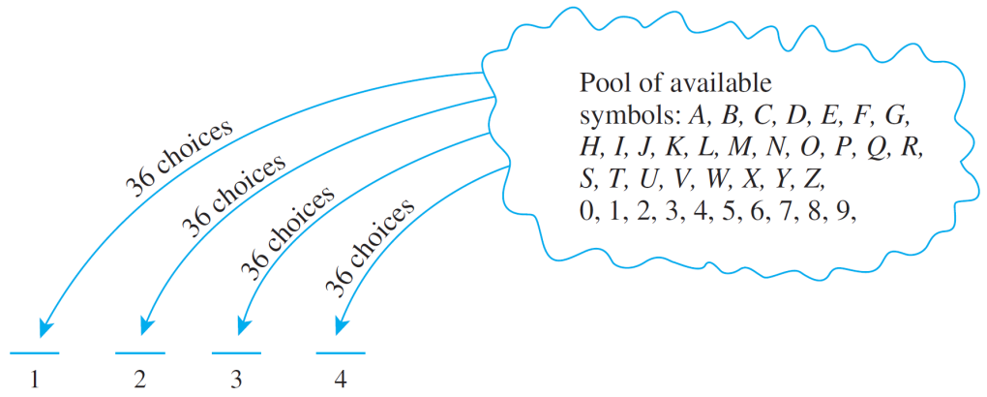
The Multiplication Rule
Example 1: No. of Personal Identification Numbers (PINs)
A typical PIN is a sequence of any four symbols chosen from the 26 letters in the alphabet and the ten digits, with repetition allowed. Examples: CARE, 3387, B32B, and so forth.
How many different PINs are possible?
You can think of forming a PIN as a four-step
operation to fill in each
of the four symbols in
sequence.

Slide 6
Example 1: No. of Personal Identification Numbers (PINs)
Step 1: Choose the first symbol.
Step 2: Choose the second symbol.
Step 3: Choose the third symbol.
Step 4: Choose the fourth symbol.
There is a fixed number of ways to perform each step, namely 36, regardless how preceding steps were performed.
Hence, by the multiplication rule, there are:
36×36×36×36 = 36⁴ = 1,679,616 PINs in all.

Slide 7
Example 2: No. of PINs without Repetition
Now, suppose that repetition is not allowed.
How many different PINs are there?
Step 1: Choose the first symbol.
Step 2: Choose the second symbol.
Step 3: Choose the third symbol.
Step 4: Choose the fourth symbol.
←36 ways
←35 ways
←34 ways
←33 ways
Hence, by the multiplication rule, there are:
36×35×34×33 = 1,413,720 PINs in all with no repeated symbol.

Slide 8
The Addition Rule
The basic rule underlying the calculation of the number of elements in a union or difference or intersection is the addition rule.
Theorem 8.2 The Addition Rule
Suppose a finite set A equals the union of k distinct mutually disjoint subsets A₁, A₂, …, A_{k}. Then
N(A) = N(A₁) + N(A₂) + … + N(A_{k}).

Slide 9
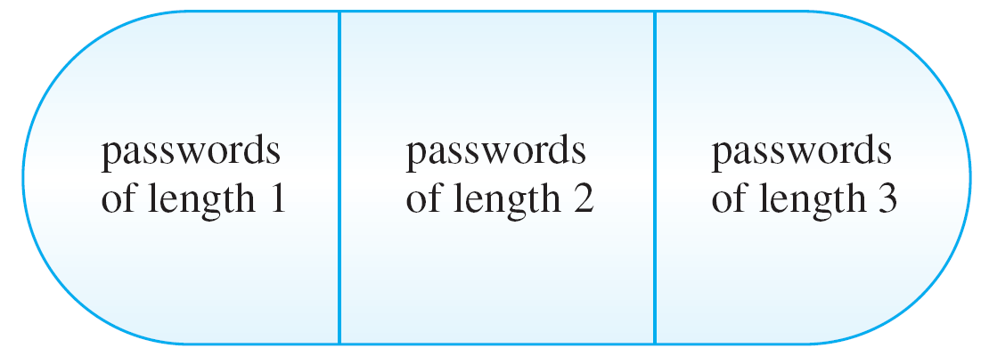
Counting Elements of Disjoint Sets: The Addition Rule
Example 3 – Counting Passwords with 3 or fewer Letters
A computer access password consists of from one to three letters chosen from the 26 letters in the alphabet with repetitions allowed. How many different passwords are possible?
The set of all passwords can be partitioned into subsets consisting of those of length 1, length 2, and length 3:

Slide 10
Counting Elements of Disjoint Sets: The Addition Rule
Example 3 – Counting Passwords with 3 or fewer Letters
By the addition rule, the total number of passwords equals the sum of the number of passwords of length 1, length 2, and length 3.
Number of passwords of length 1 = 26
Number of passwords of length 2 = 26²
Number of passwords of length 3 = 26³
Hence, total number of passwords = 26 + 26² + 26³
= 18,278.

Slide 11
The Addition Rule
Example 4 – Counting PINs with Repeated Symbols
A typical PIN (personal identification number) is a sequence of any four symbols chosen from the 26 letters in the alphabet and the ten digits, with repetition allowed. How many PINs contain repeated symbols?
There are 36⁴ = 1,679,616 PINs when repetition is allowed, and there are 36 × 35 × 34 × 33 = 1,413,720 PINs when repetition is not allowed.
As the set of all PINs is the disjoint union of the set of PINs containing repeated symbols and the set of PINs without containing repeated symbols
By the addition,
1,679,616 = the no of PINs containing repeated symbols + 1,413,720
The no of PINs containing repeated symbols = 1,679,616 – 1,413,720
= 265,896

Slide 12
Permutations
A permutation of a set of objects is an ordering of the objects in a row. For example, the set of elements a, b, and c has six permutations.
abc acb cba bac bca cab
In general, given a set of n objects, how many permutations does the set have?

Slide 13
Permutations
Imagine forming a permutation as an n-step operation:
Step 1: Choose an element to write first.
Step 2: Choose an element to write second.
Step 3: Choose an element to write third.
:
Step n: Choose an element to write nth.
← n ways
← n – 1 ways
← n – 2 ways
← 1 way
By the multiplication rule, there are
n × (n – 1) × (n – 2) × … × 2 × 1 = n!
ways to perform the entire operation.

Slide 14
Permutations
In other words, there are n! permutations of a set of n elements.
Theorem 8.3 Permutations
The number of permutations of a set with n (n ≥ 1) elements is n!

Slide 15
Permutations
Example 5 – Permutations of the Letters in a Word
How many ways can the letters in the word COMPUTER be arranged in a row?
All the eight letters in the word COMPUTER are distinct. Hence, 8! = 40320.
How many ways can the letters in the word COMPUTER be arranged if the letters CO must remain next to each other (in order) as a unit?
There are effectively only seven objects “CO”, “M”, “P”, “U”, “T”, “E” and “R”. Hence, 7! = 5040.

Slide 16
Permutations
Permutations of Selected Elements
Given the set {a, b, c}, there are six ways to select two letters from the set and write them in order.
ab ac ba bc ca cb
Each such ordering of two elements of {a, b, c} is called a 2-permutation of {a, b, c}?.
Definition
An r-permutation of a set of n elements is an ordered selection of r elements taken from the set.
The number of r-permutations of a set of n elements is denoted P(n, r).

Slide 17
Permutations of Selected Elements
Theorem 8.4 r-permutations from a set of n elements
If n and r are integers and 1 ≤ r ≤ n, then the number of r-permutations of a set of n elements is given by the formula
P(n, r) = n(n – 1)(n – 2) … (n – r + 1) first version
or, equivalently,
P(n, r) = second version
n!
(n – r)!

Slide 18
Permutations of Selected Elements
Example 6
Evaluate P(5, 2).
P(5, 2) = 5! / (5 – 2)! = 5 × 4 = 20
How many 4-permutations are there of a set of seven objects?
P(7, 4) = 7! / (7 – 4)! = 7 × 6 × 5 × 4 = 840
How many 5-permutations are there of a set of five objects?
P(5, 5) = 5! / (5 – 5)! = 5! = 120

Slide 19

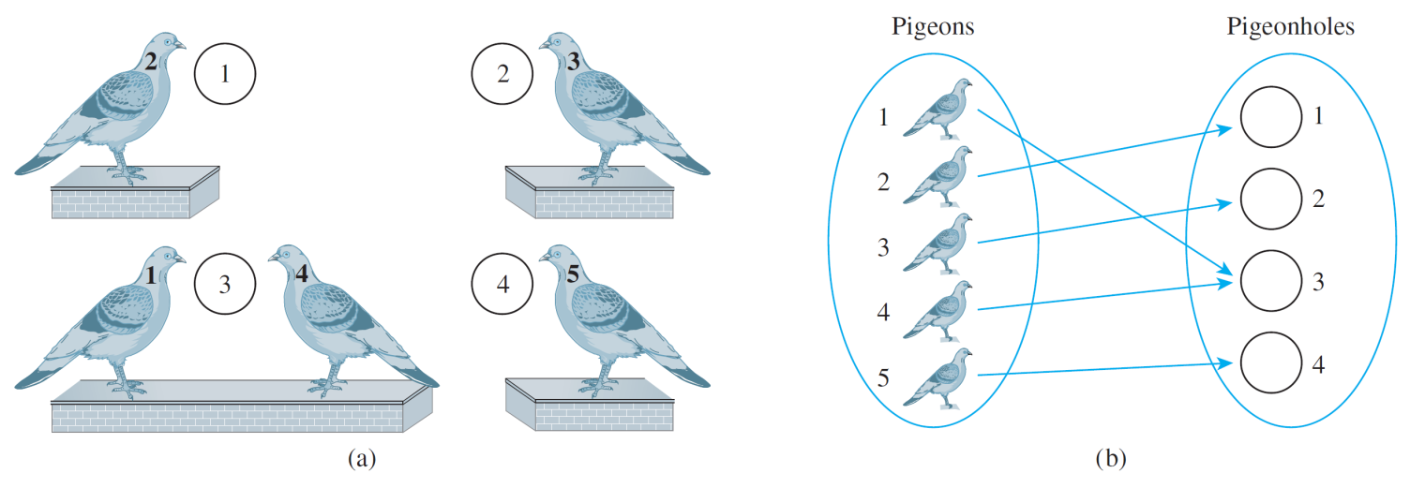
S
The Pigeonhole Principle
If n pigeons fly into m pigeonholes and n > m, then at least one hole must contain two or more pigeons. (sometimes called the Dirichlet box principle as it was first stated formally by J. P. G. L. Dirichlet (1805–1859)).
Mathematical formulation:
Pigeonhole Principle
A function from one finite set to a smaller finite set cannot be one-to-one: There must be at least 2 elements in the domain that have the same image in the co-domain.

Slide 20
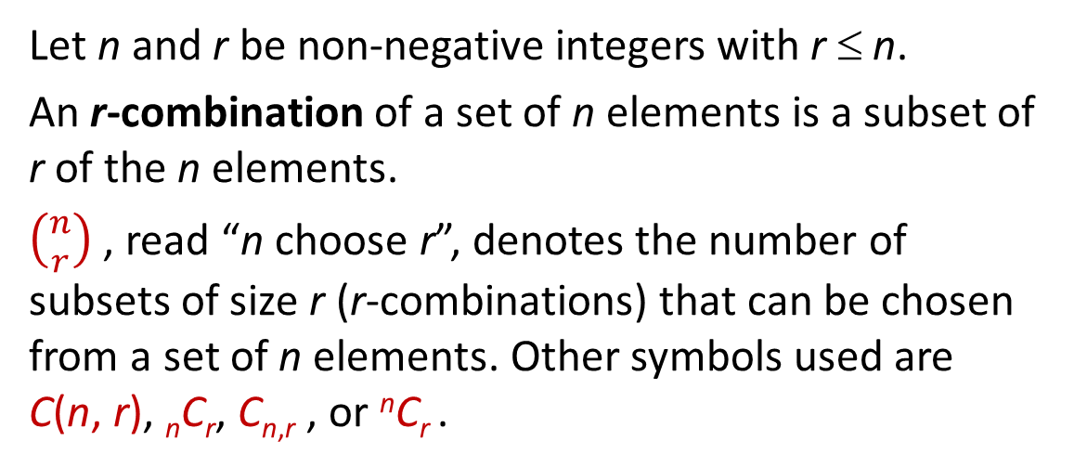
Counting Subsets of a Set: Combinations
Given a set S with n elements, how many subsets of size r can be chosen from S?
Each subset of size r is called an r-combination of the set.
Definition: r-combination
Let n and r be non-negative integers with r ≤ n.
An r-combination of a set of n elements is a subset of r of the n elements.
$\left({n \atop r}\right)$ , read “n choose r”, denotes the number of subsets of size r (r-combinations) that can be chosen from a set of n elements. Other symbols used are C(n, r), _{n}C_{r}, C_{n,r} , or ^{n}C_{r} .

Slide 21
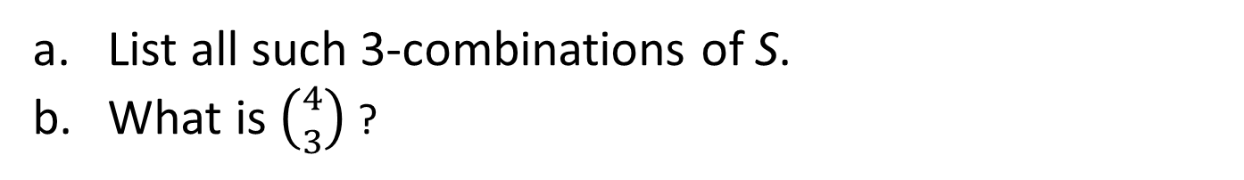
Counting Subsets of a Set: Combinations
Example 7 - Combinations
Let S = {Ann, Bob, Cyd, Dan}. Each committee consisting of three of the four people in S is a 3-combination of S.
List all such 3-combinations of S.
What is $\left({4 \atop 3}\right)$ ?
The 3-combinations are:
{Bob, Cyd, Dan}, {Ann, Cyd, Dan},
{Ann, Bob, Dan}, {Ann, Bob, Cyd}
$\left({4 \atop 3}\right)$ = 4

Slide 22

Relationship between Permutations and Combinations
Theorem 8.5 Formula for $\left({n \atop r}\right)$
The number of subsets of size r (or r-combinations) that can be chosen from a set of n elements, $\left({n \atop r}\right)$, is given by the formula
$\left({n \atop r}\right)= \frac{P(n, r)}{r!}$
or, equivalently,
$\left({n \atop r}\right)= \frac{n!}{r!\left(n−r\right)!}$
where n and r are non-negative integers with r ≤ n.

Slide 23

Relationship between Permutations and Combinations
Example 8 – Teams with Members of Two Types
Suppose the group of 12 consists of 5 men and 7 women.
How many 5-person teams can be chosen that consist of 3 men and 2 women?
Hint: Think of it as a two-step process:
Step 1: Choose the men.
Step 2: Choose the women.
$$\left({5 \atop 3}\right)×\left({7 \atop 2}\right)= \frac{5!}{3!2!}×\frac{7!}{2!5!}=210$$

Slide 24


Relationship between Permutations and Combinations
Example 8 – Teams with Members of Two Types
Suppose the group of 12 consists of 5 men and 7 women.
How many 5-person teams contain at least one man?
Hint: May use difference rule or addition rule.
The former is shorter.
Let A be the set of all 5-person teams,
and B be the set of 5-person teams without any men.
$$\left({12 \atop 5}\right)=792$$
$$\left({7 \atop 5}\right)=21$$
Then N(A) = , and N(B) =
Therefore number of 5-person teams that contain at least one man =
792 – 21 = 771

Slide 25
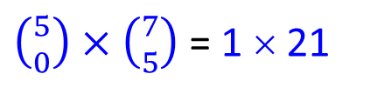
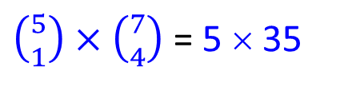
Relationship between Permutations and Combinations
Example 8 – Teams with Members of Two Types
Suppose the group of 12 consists of 5 men and 7 women.
How many 5-person teams contain at most one man?
$\left({5 \atop 0}\right)×\left({7 \atop 5}\right)$ = 1 × 21
Number of teams without any man =
= 21
$\left({5 \atop 1}\right)×\left({7 \atop 4}\right)$ = 5 × 35
Number of teams with one man =
= 175
Therefore number of 5-person teams that contain at most one man =
21 + 175 = 196

Slide 26
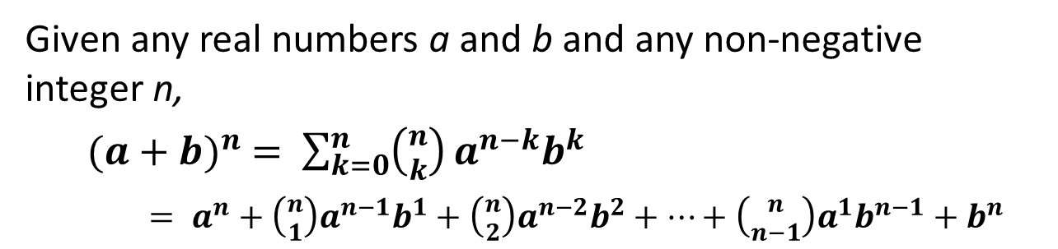
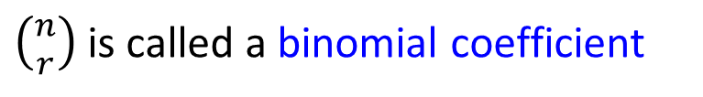
The Binomial Theorem
In algebra a sum of two terms, such as a + b, is called binomial.
The binomial theorem gives an expression for the powers of a binomial (a + b)^{n}, for each positive integer n and all real numbers a and b.
$\left({n \atop r}\right)$is called a binomial coefficient
Theorem 8.6 Binomial Theorem
Given any real numbers a and b and any non-negative integer n,
${(a+b)}^{n} = \sum_{k=0}^{n}{\left({n \atop k}\right)}a^{n−k}b^{k}$
$= a^{n}+\left({n \atop 1}\right)a^{n−1}b^{1}+\left({n \atop 2}\right)a^{n−2}b^{2}+⋯+\left({n \atop n−1}\right)a^{1}b^{n−1}+b^{n}$

Slide 27
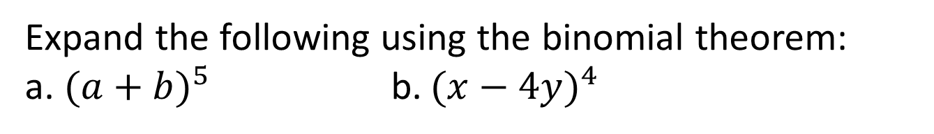
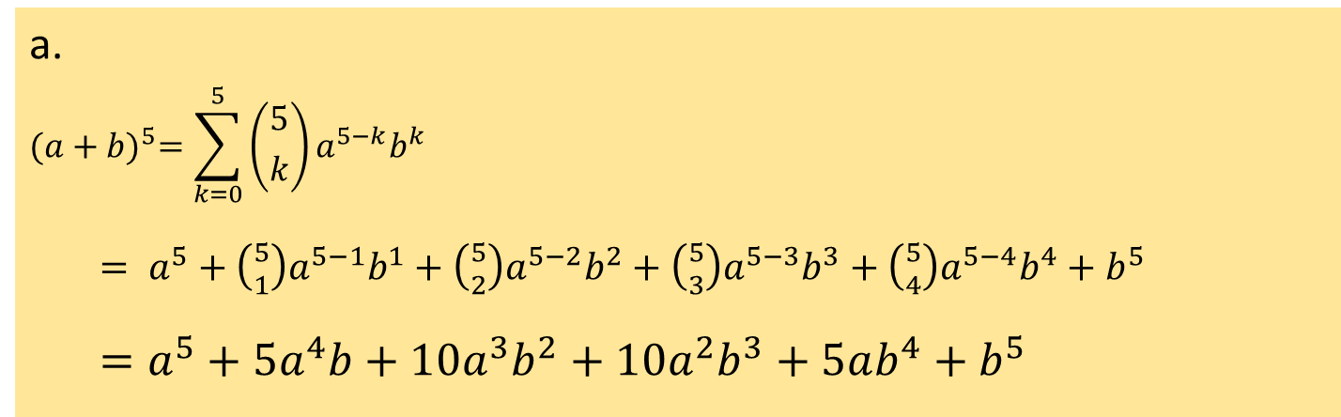
The Binomial Theorem
Example 9 – Substituting into the Binomial Theorem
Expand the following using the binomial theorem:
a. ${(a+b)}^{5}$ b. ${(x−4y)}^{4}$
a.
$${(a+b)}^{5}=\sum_{k=0}^{5}{\left({5 \atop k}\right)}a^{5−k}b^{k}$$
$= a^{5}+\left({5 \atop 1}\right)a^{5−1}b^{1}+\left({5 \atop 2}\right)a^{5−2}b^{2}+\left({5 \atop 3}\right)a^{5−3}b^{3}+\left({5 \atop 4}\right)a^{5−4}b^{4}+b^{5}$
$=a^{5}+5a^{4}b+10a^{3}b^{2}+10a^{2}b^{3}+5ab^{4}+b^{5}$

Slide 28
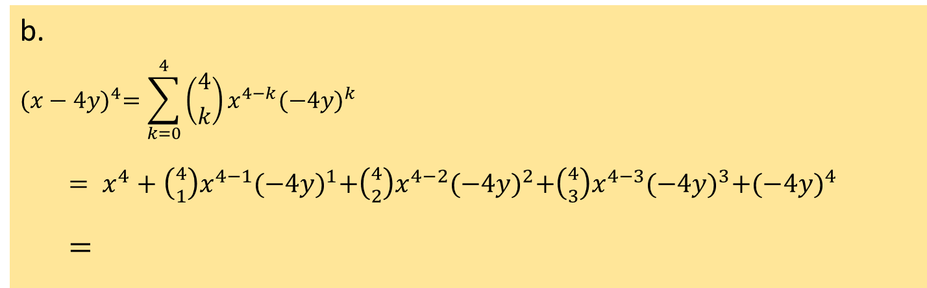
The Binomial Theorem
Example 9 – Substituting into the Binomial Theorem
Expand the following using the binomial theorem:
a. ${(a+b)}^{5}$ b. ${(x−4y)}^{4}$
b.
$${(x−4y)}^{4}=\sum_{k=0}^{4}{\left({4 \atop k}\right)}x^{4−k}{(−4y)}^{k}$$
$= x^{4}+\left({4 \atop 1}\right)x^{4−1}{(−4y)}^{1}+\left({4 \atop 2}\right)x^{4−2}{(−4y)}^{2}+\left({4 \atop 3}\right)x^{4−3}{(−4y)}^{3}+{(−4y)}^{4}$
$=$
$$x^{4}−16x^{3}y+96x^{2}y^{2}−256xy^{3}+256y^{4}$$

Slide 29
End of Unit 8

